Slide 1
Team
Sprint 6
Reed Inderwiesche, Jacob Moore, James Craig, Zack Sprague, Josh McGuire, Chris Wells

Slide 2
Jacob Moore/Team Leader
Task:
(New feature) Added new member status that is awarded to members who have been a member of the website for a long time.
Newbie (<1 year)
Novice (>1 year && <3 years)
Master (>3 years)

Slide 3
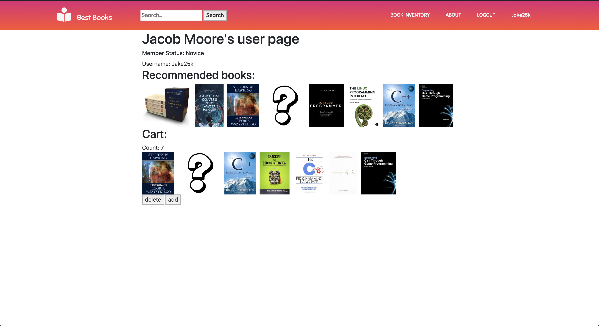

Slide 4
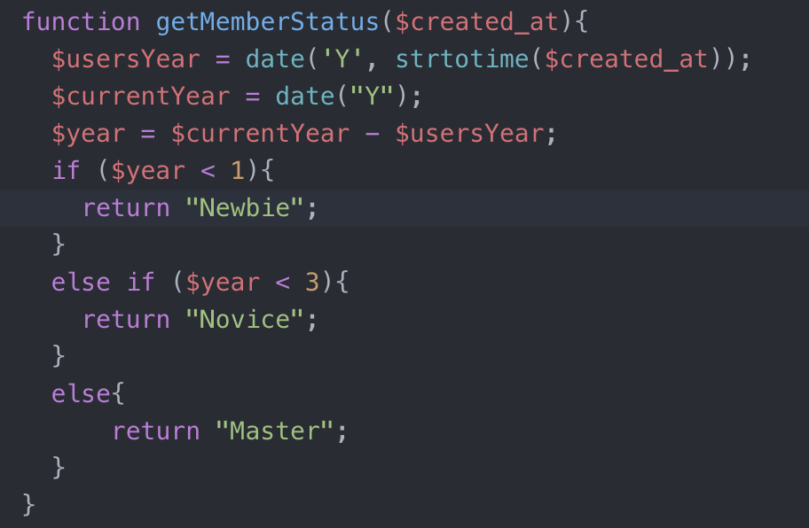
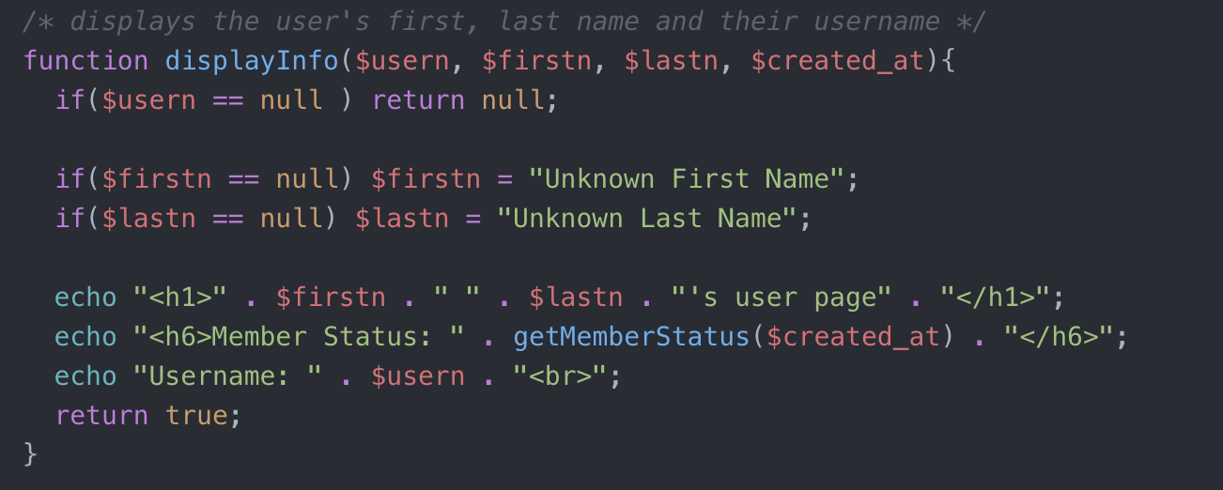
The code:

Slide 5
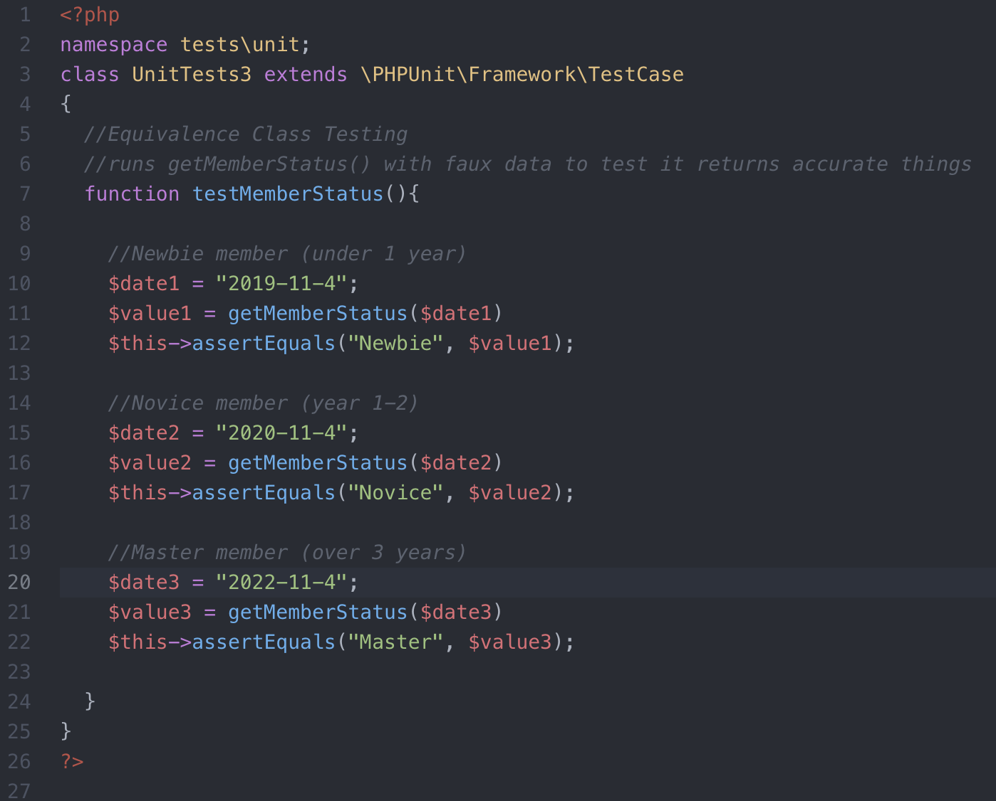
PHPUnit Blackbox testing:

Slide 6
James Craig -- Tester
Revamp the View Cart link
Testing – test had been done on a previous sprint for the link
Added the shopping cart icon
Moved the link to different location
Made the link bigger
No Blackbox testing

Slide 7
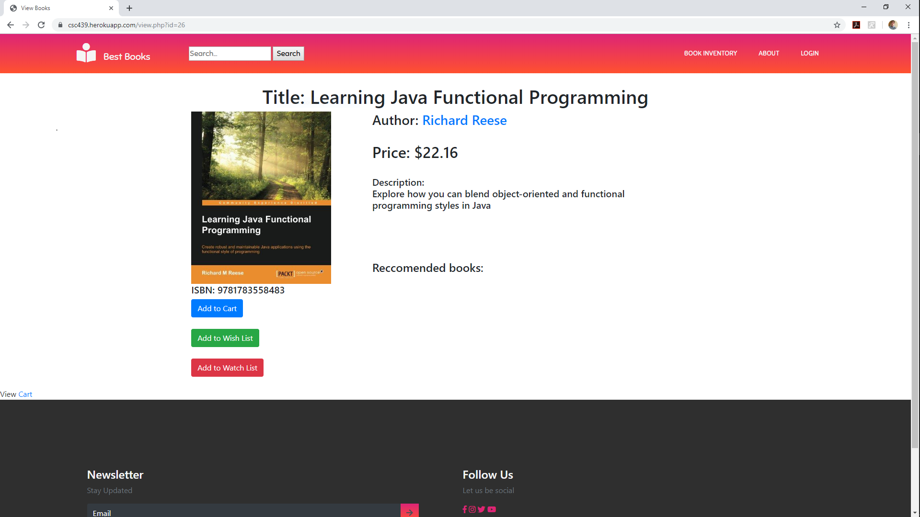
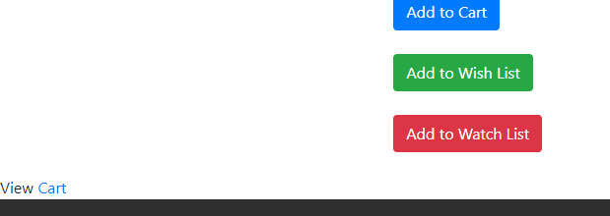

Slide 8
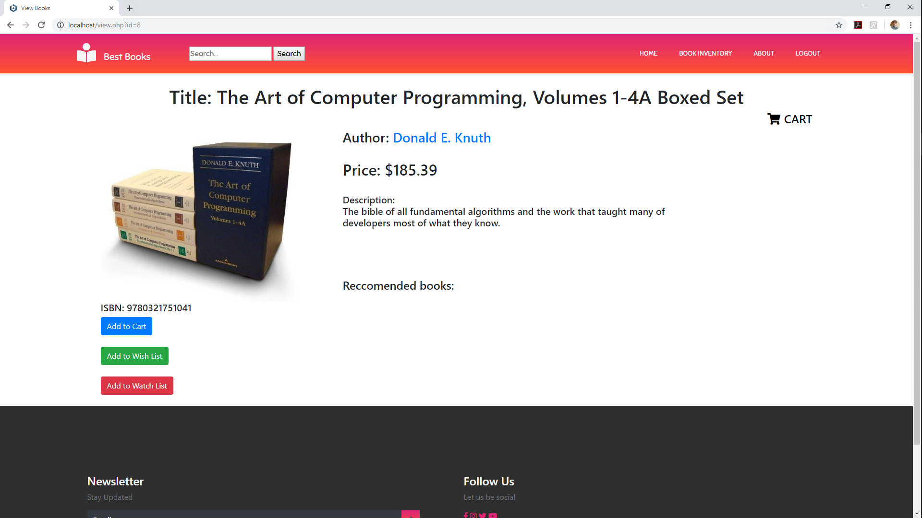

Slide 9
Josh McGuire Configuration Manager
Black Box test for the prices of books and then categorized them based on how much it costs.
if ($price <= 10) cost="Cheap"; if ($price <= 40) cost="Moderate"; if ($price <= 100) cost="Expensive"; if ($price > 100) cost="Really Expensive“

Slide 10
Tester: Zack Sprague
Made button on footer for user to be able to sign up for newsletters.
User must have an account and be logged in before able to sign-up for newsletters.
Redirects user to login page if email is not present in the database.

Slide 11
Decision table testing– If a user receives the newsletters
 | Rule 1 | Rule 2 | Rule 3 | Rule 4
Conditions
Has Account? | Yes | Yes | No | No
Wants Newsletter? | Yes | No | Yes | No
Actions
Receive Newsletter? | Yes | No | No | No

Slide 12
SCM Manager: Chris Wells
Add the number of books that a user has in their cart to the website header for user reference.
Old Header
New Header

Slide 13
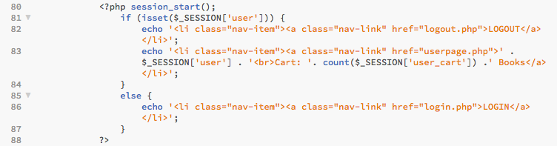
SCM Manager: Chris Wells
Modified Code

Slide 14
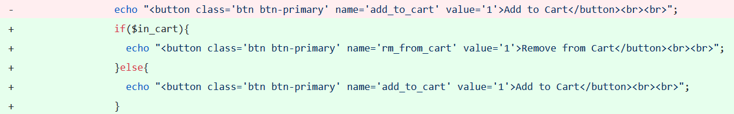
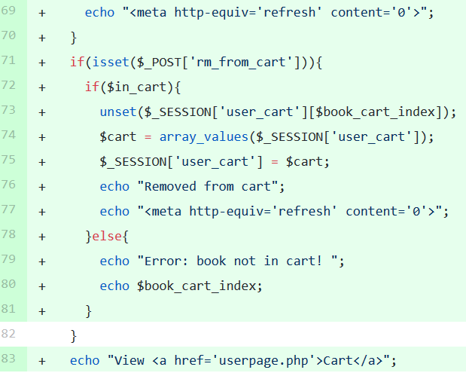
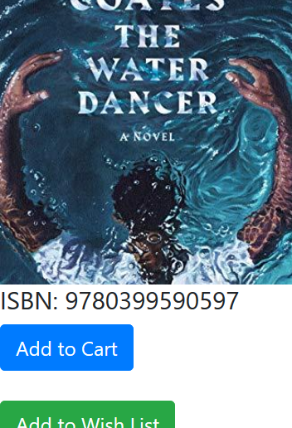
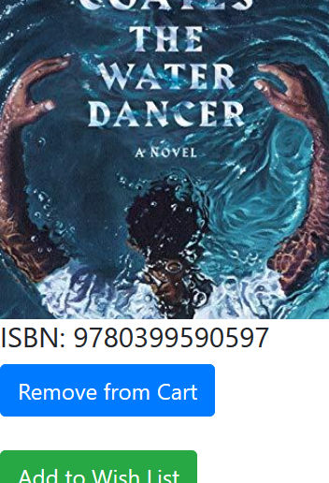
Reed Inderwiesche – Build Manager
Add/Remove from cart button
If the book is already in the cart, Add to Cart turns into Remove from Cart

